Slide 1

Project Demo 1 Exploratory Data Analysis on Go-Auto Dataset || A Regression Approach to Predict Optimal Vehicle Pricing
Student name: Bube Ohaneje, Ayo Pedro, Emem Antia & Monsurat Adejumo
Course name: CMPT 3830: ML Work Integrated Project 1
Date: 10th Feb 2025
Instructor: MD Mishu Mahbub

Slide 2
Problem Statement
Pricing Model (Regression): The goal is to develop a regression model that can predict the optimal pricing of a vehicle based on its characteristics such as year, make, model, and mileage.
Objective: Help dealerships fine-tune their pricing strategies to maximize sales and remain competitive by estimating vehicle prices based on key attributes.

Slide 3
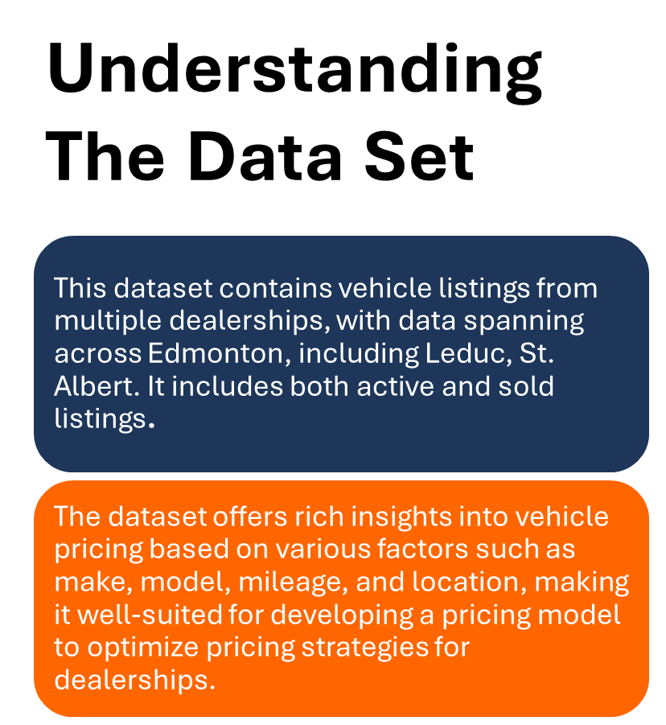
Description of the Go-auto Data set
This dataset captures vehicle listings from multiple dealership across Edmonton, offering a detailed snapshot of the market. Here are some important features that you will find in the dataset:
Vehicle Information: Make, model, year, engine type, transmission, mileage, exterior color, interior color, series, style
Pricing information: Price, Price analysis. & number of price changes
Dealer information: Dealership name, province, URL, Postal_Code, Id, type, street, city, phone.
Listing details: id, heading, first_date, dropoff_date
Location & Distance: Distance from the user to the dealership and location score

Slide 4

Understanding EDA ( Exploratory Data Analysis)
EDA is the first step in analyzing a dataset. It is like taking a close look at your data to understand what’s inside before you start making predictions. Here are some general EDA steps:
Clean the Data: Sometimes the data might have mistakes, missing values, or duplicates. EDA helps you find and fix those issues
Visualize the Data: Create charts and graphs to see trends, patterns, and relationships between different variables.
Find Patterns: Look for insights like how different features (e.g., mileage) affect the outcome (e.g., price) and detect any unusual data points (outliers).
Summarize the Data: Provide an overview of the key findings and insights from the dataset to guide further analysis or model building.

Slide 5

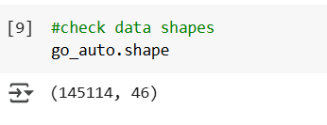
EDA ON Go Auto’s Dataset
Loading the dataset into the Python environment:
\
Inspected the data:
To check the number of row and columns:

Slide 6
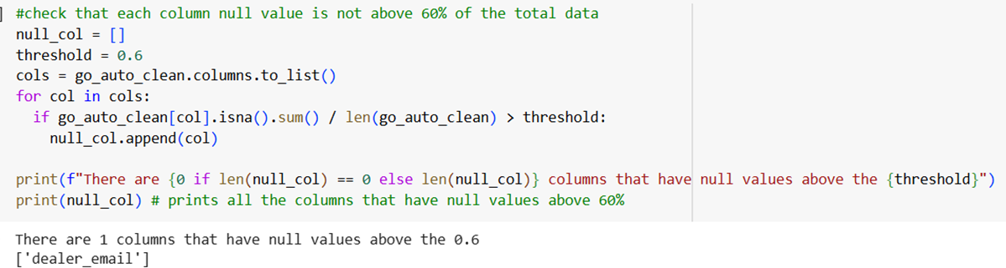
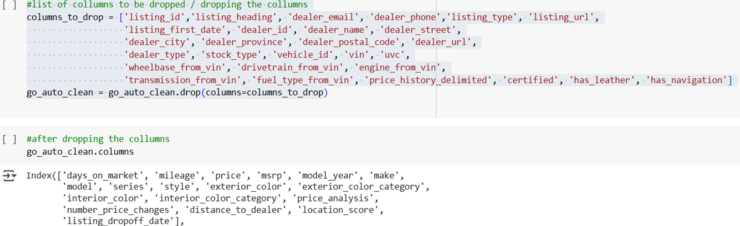
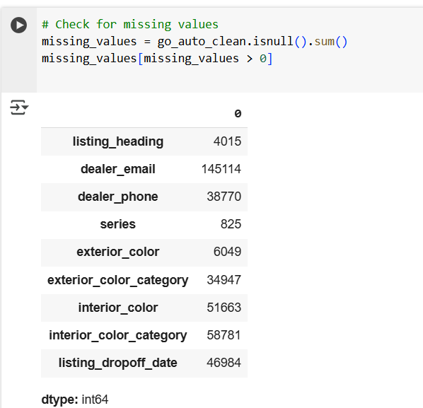
EDA On Go Auto’s Dataset
Other data cleaning done:
Checking for duplicated data( About 2,276 duplicated data was removed)
Converted the listing_dropoff_date to a DateTime data type
We used the Next observation carried backward (NOCB) and Last Observation carried forward (LOCF) to impute the missing data in the drop off date column

Slide 7
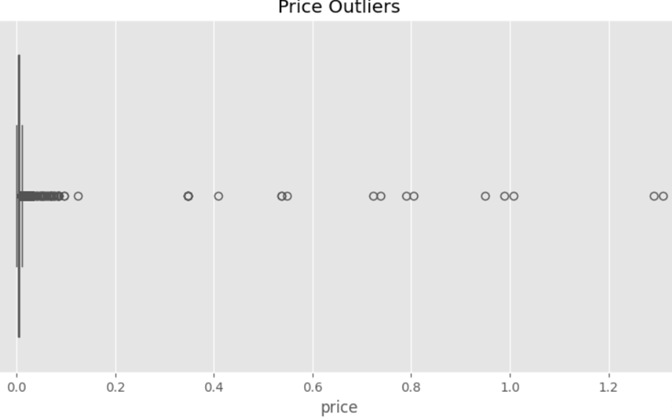
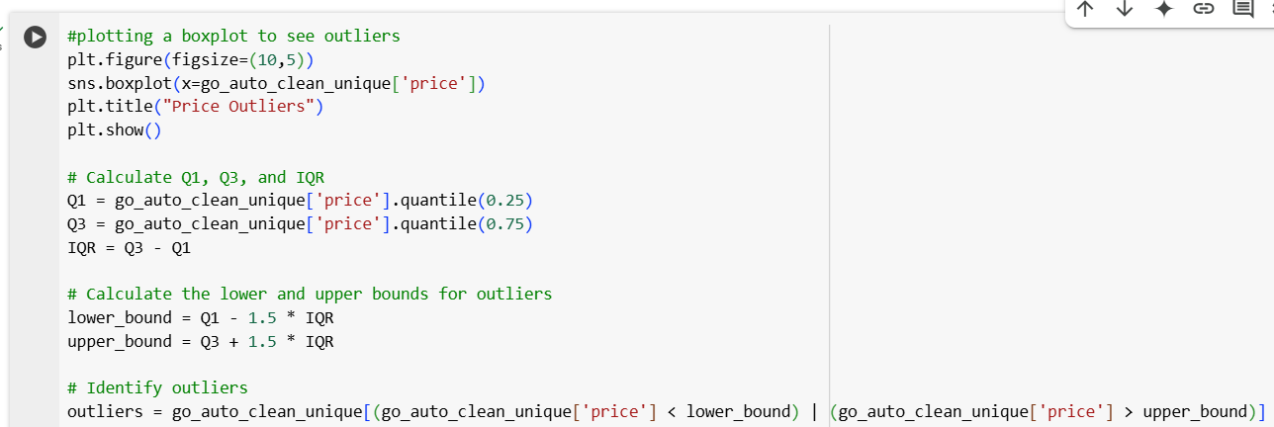
EDA On Go Auto’s Dataset (Checking for Outliers).
This boxplot show case the outliers in the price value. And we used the Interquatile range method (IQR) to get the outliers

Slide 8
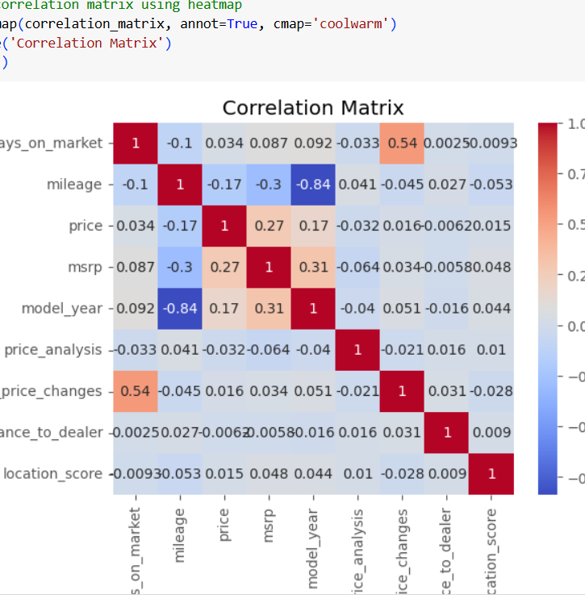
EDA On Go Auto’s Dataset (correlation matrice).
Checking the correlation between numerical features helps to understand how strongly the variables are related to each other
Mileage vs. Model Year (-0.84): This shows very strong negative correlation; this means newer cars have lower mileage
Number of Price Changes vs. Days on Market(0.54): This shows strong positive correlation, meaning that cars that stay longer on the market have more price adjustments

Slide 9
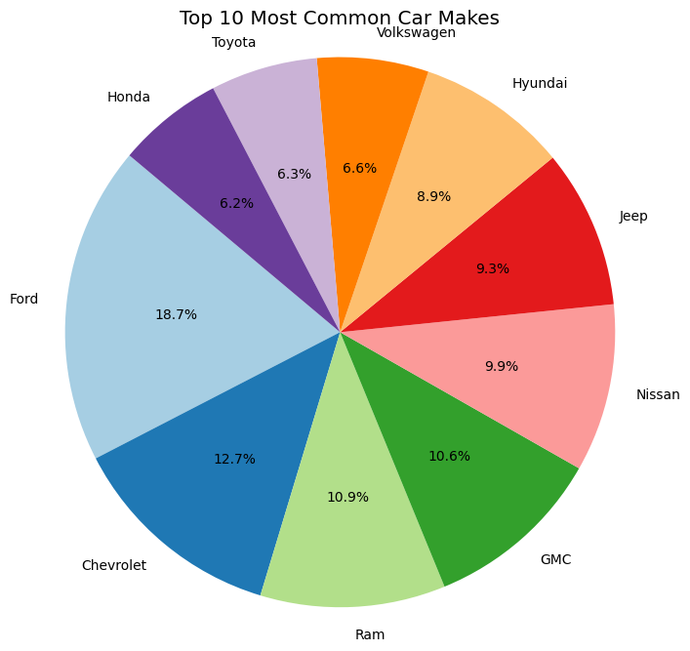
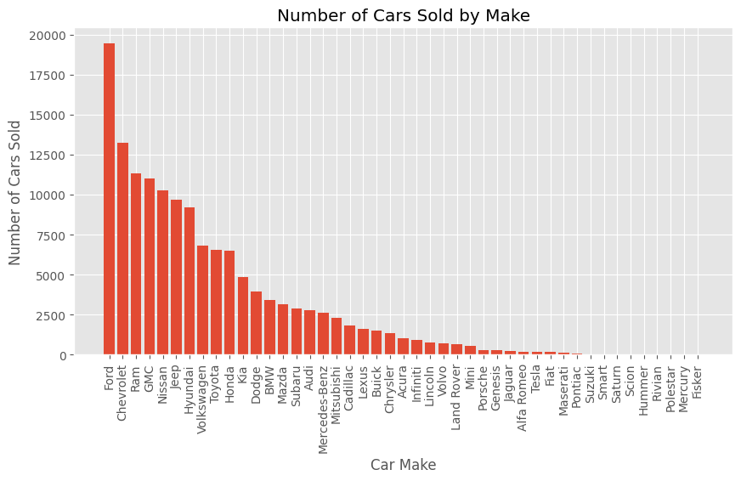
EDA On Go Auto’s Dataset (Visualization).
Here are the most common car make we found in the data with Ford leading as the highest.
Also checked for the number of car sold by make

Slide 10
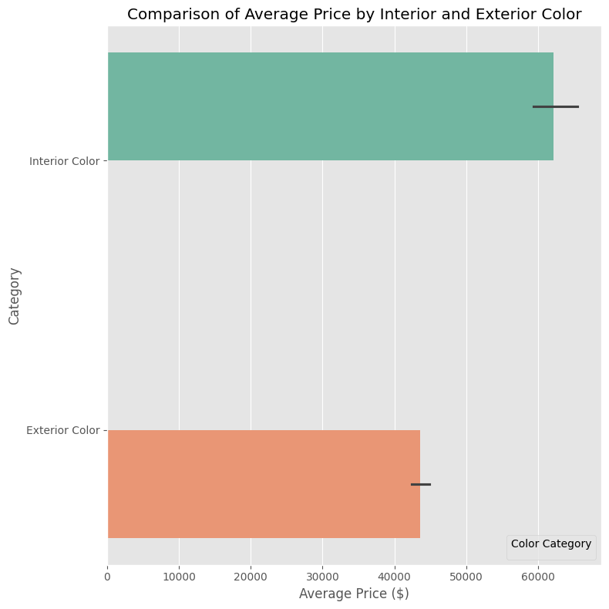
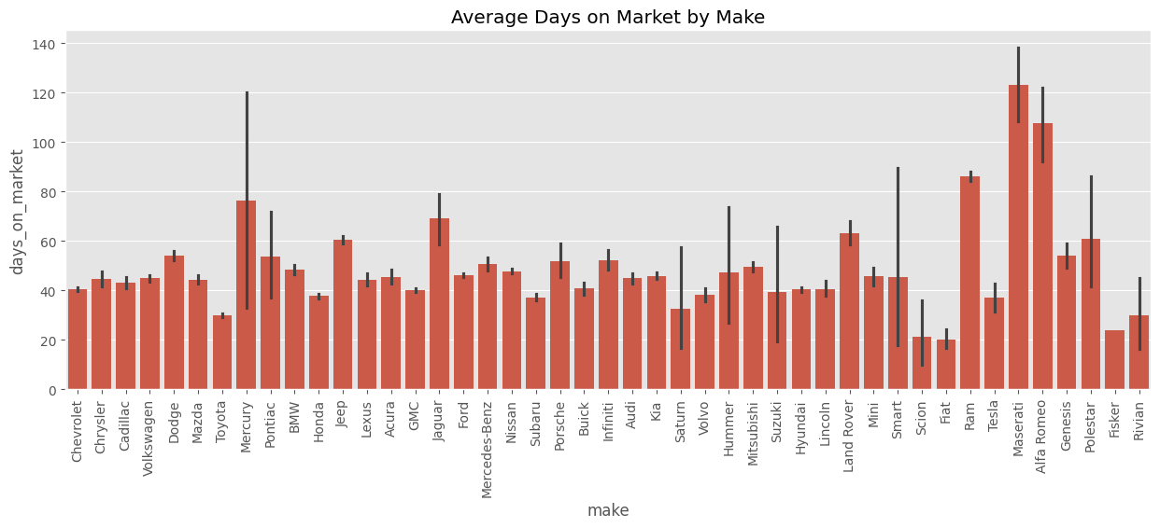
EDA On Go Auto’s Dataset (Visualization).
The first graph compares the average price of vehicles based on interior and exterior color, with interior color categories commanding higher prices.
The second graph shows the average number of days vehicles remain on the market by make, with some makes like Maserati having notably higher value

Slide 11
Results Obtained After performing EDA
Price Distribution & Outliers:
Most cars cost less than $100,000, but some are significantly overpriced.
Luxury brands (Mercedes-Benz, Tesla, Maserati, etc.) have very high prices, likely due to rare models or data errors.
Mileage Trends & Depreciation:
Newer cars have lower mileage, while older cars have higher mileage.
Higher mileage usually lowers price, but some cars still hold value due to brand or condition.
Next Step: Group cars into high-value vs. low-value depreciation to better predict resale prices.
Days on Market Insights
Older, high-mileage cars tend to sell faster, while newer, expensive cars stay on the market longer.
Next Step: Analyzing optimal pricing strategies to reduce listing duration.
Brand-Level Price Variations
Luxury brands (Jaguar, Porsche, Tesla, Maserati) have wider price ranges, indicating they cater to both premium and standard markets.
Mass-market brands (Toyota, Honda, Nissan, Chevrolet) have stable, lower prices, suggesting predictable resale value.
Next Step: Segmenting brands into budget, mid-range, and luxury categories to refine pricing models.

Slide 12

Thank you

